Slide 1
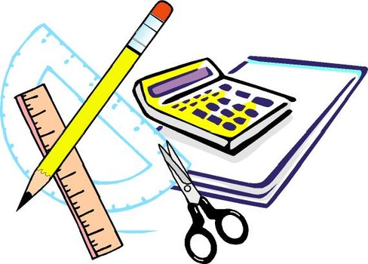
Learning Objective
I will calculate probabilities from Venn diagrams
Enter quietly, please be ready with the following on your desk:
Whiteboard
Whiteboard marker
Exercise Book
Pencil, pen, ruler and red pen
Diary
Calculator
Device – charged or borrowed from Library before maths

Slide 2



Daily Review
 | Year 7 | Year 8 | Year 9 | TOTAL
Boys | 9 | 8 | 12 | 29
Girls | 4 | 10 | 7 | 21
TOTAL | 13 | 18 | 19 | 50
If I was to choose a pupil at random, what is the probability of selecting a Year 8 pupil?
Pr(Year 8) =
What is the probability that a pupil selected at random will be a boy?
Pr(boy) =
If a Year 7 pupil is selected, what is the probability that they are a girl?
Pr(girl if Year 7) =
$$\frac{18}{50}=\frac{9}{25}$$
 | Year 7 | Year 8 | Year 9 | TOTAL
Boys | 9 | 8 | 12 | 29
Girls | 4 | 10 | 7 | 21
TOTAL | 13 | 18 | 19 | 50
$$\frac{29}{50}$$
 | Year 7 | Year 8 | Year 9 | TOTAL
Boys | 9 | 8 | 12 | 29
Girls | 4 | 10 | 7 | 21
TOTAL | 13 | 18 | 19 | 50
$$\frac{4}{13}$$

Slide 3
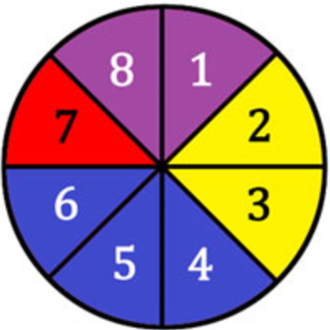
Learning Objective
CFU 1
What will we learn?
I will find probabilities from Venn diagrams.
CFU 2
What will we learn?
Success Criteria
I will be able to list sample spaces.
I will be able to calculate probabilities of single events.
I will be able to calculate probabilities of complementary events.
I will find probabilities from Venn diagrams.

Slide 4
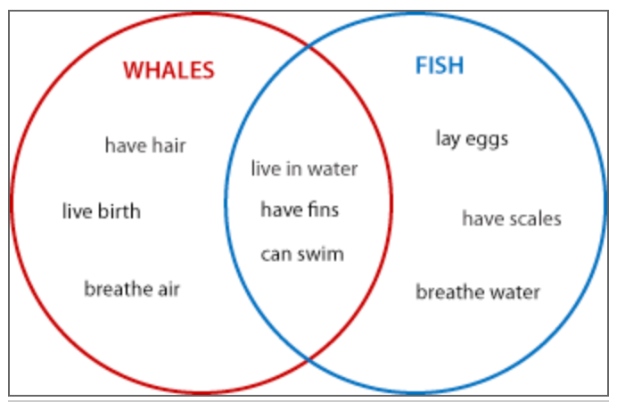
Concept Development
There are three parts to this Venn Diagram.
What are they?
Things that are true for whales.
Things that are true for fish.
Things that are true for both whales and fish.

Slide 5
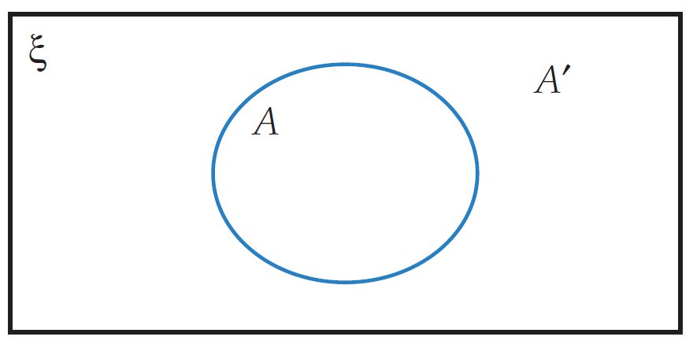

Concept Development
A Venn diagram is a rectangle that contains all possible outcomes of an event, the universal set. It is represented by the symbol Ꜫ.
The outcomes of an event are contained in a circle, with a letter, such as A.
All the outcomes that don’t fit that event go outside the circle. They are A´ (not A).
$$Ꜫ$$
Ꜫ

Slide 6
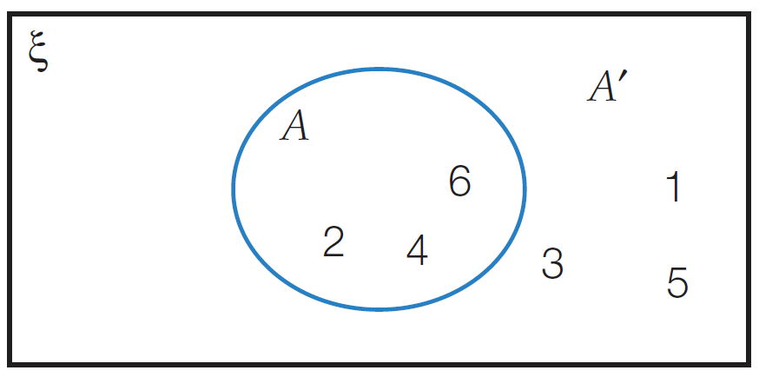

Skill Development
If we roll a dice and we are interested in rolling even numbers only
Ꜫ = (1, 2, 3, 4, 5, 6)
A = (2, 4, 6)
A´ = (1, 3, 5)
$$Ꜫ$$
Ꜫ

Slide 7
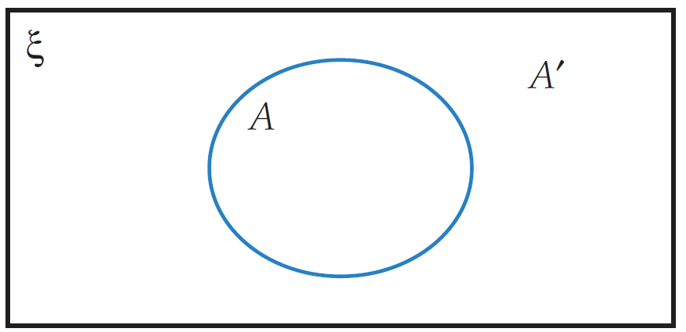

Skill Development
If we roll a dice and we are interested in rolling square numbers only,
Ꜫ = ( ? ) A = ( ? ) A´ = ( ? )
$$Ꜫ$$
1, 4
2, 3, 5, 6

Slide 8
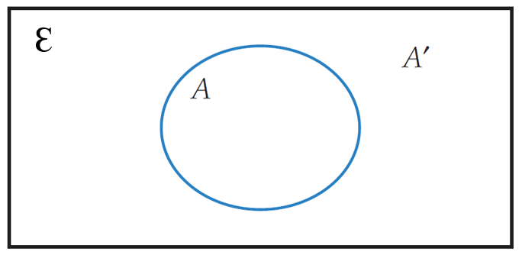
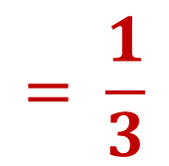
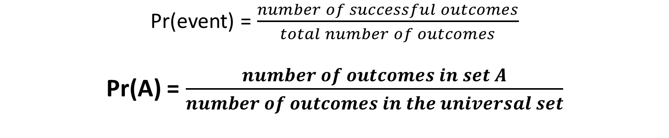
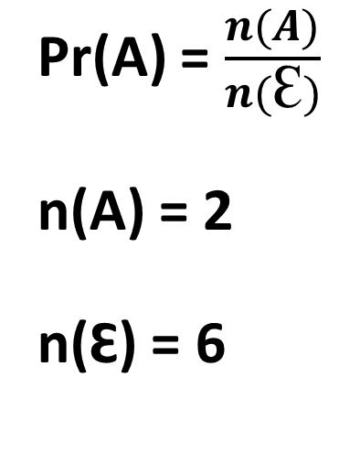
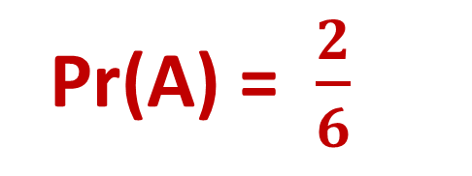
Finding probabilities with Venn diagrams
Skill Development
Pr(event) = $\frac{number of successful outcomes}{total number of outcomes}$
Pr(A) = $\frac{number of outcomes in set A}{number of outcomes in the universal set}$
Pr(A) = $\frac{n(A)}{n(Ꜫ)}$
n(A) = 2
n(Ꜫ) = 6
Pr(A) = $\frac{2}{6}$
$$= \frac{1}{3}$$

Slide 9
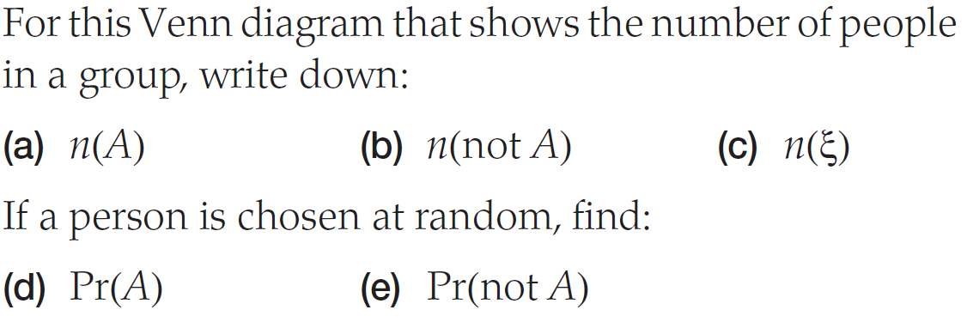
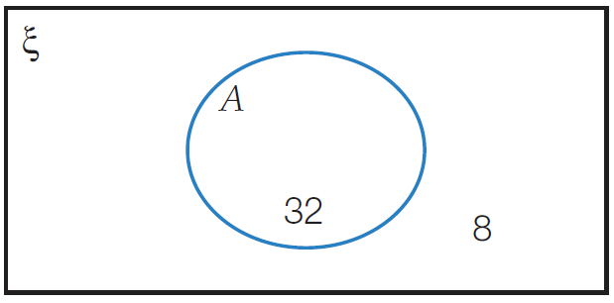

Finding probabilities with Venn diagrams
Skill Development
(a) n(A) = 32
(b) n(A´) = 8
(c) n(Ꜫ) = 40
(d) Pr(A) = $\frac{32}{40}= \frac{4}{5}$
(e) Pr(A´) = $\frac{8}{40}$ = $\frac{1}{5}$
Ꜫ

Slide 10
Concept Development
Unions and Intersections
OR = Union (all circles)
AND = Intersection (overlap)
Anything you can tell me about whales OR fish is the union of whales and fish.
Anything that is common to whales AND fish is the intersection of whales and fish.
The union of A and B is everything in A or B.
The intersection of A and B is everything that’s in both A and B.

Slide 11

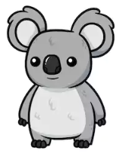
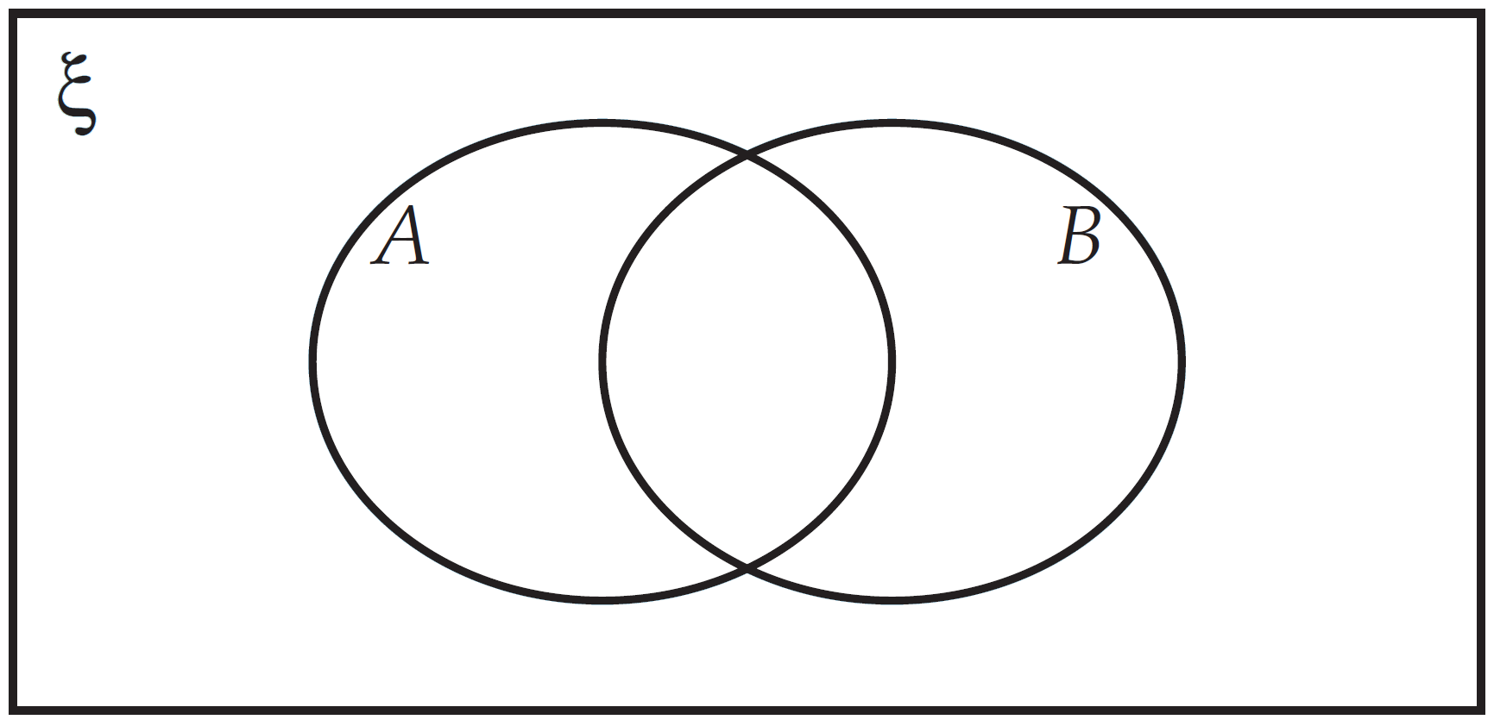
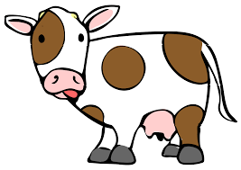
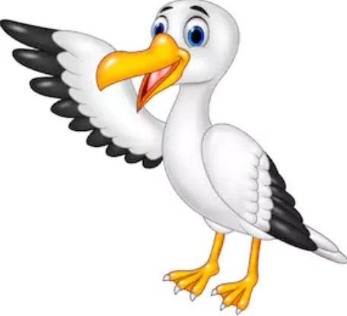


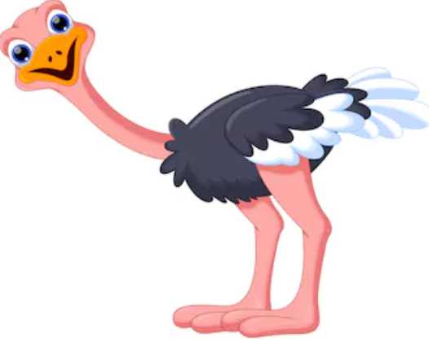



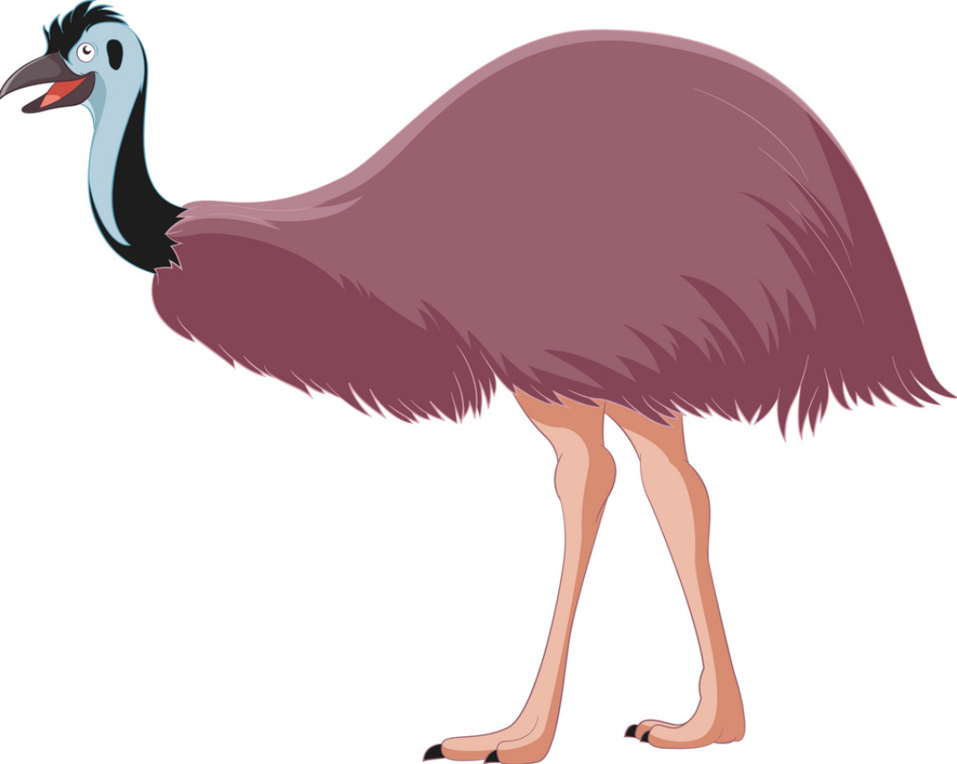

Guided Practice

Slide 12


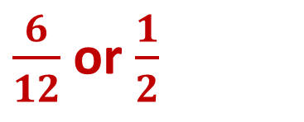
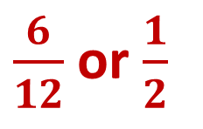

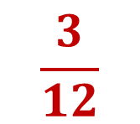
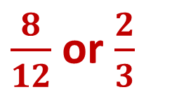
Guided Practice
$$\frac{5}{12}$$
$$\frac{3}{12}$$
(a) Pr(A) =
$\frac{6}{12}$ or $\frac{1}{2}$
(b) Pr(B) =
(c) Pr(A and B) =
(d) Pr(A’) =
$\frac{8}{12}$ or $\frac{2}{3}$
$\frac{6}{12}$ or $\frac{1}{2}$
(e) Pr(B’) =
(f) Pr(A or B) =
$$\frac{7}{12}$$

Slide 13
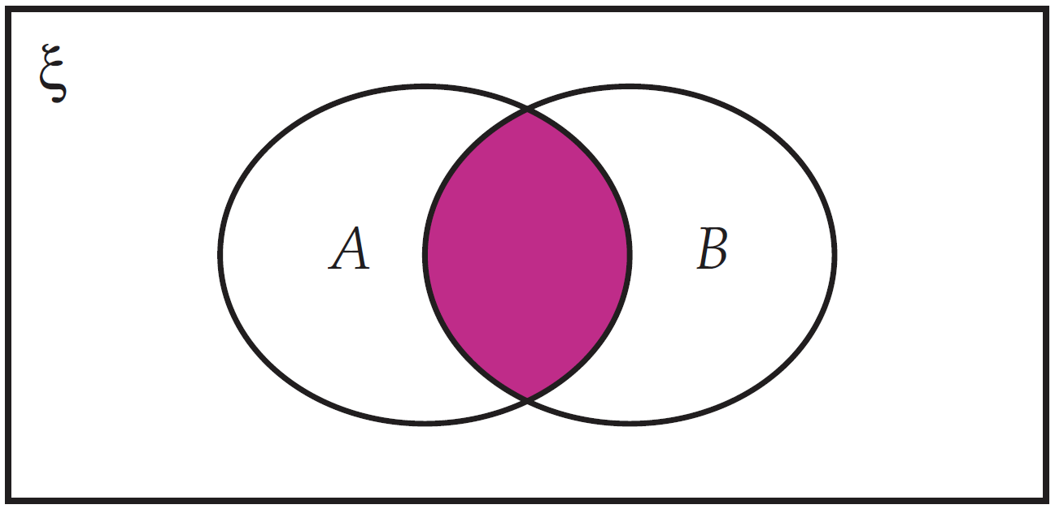
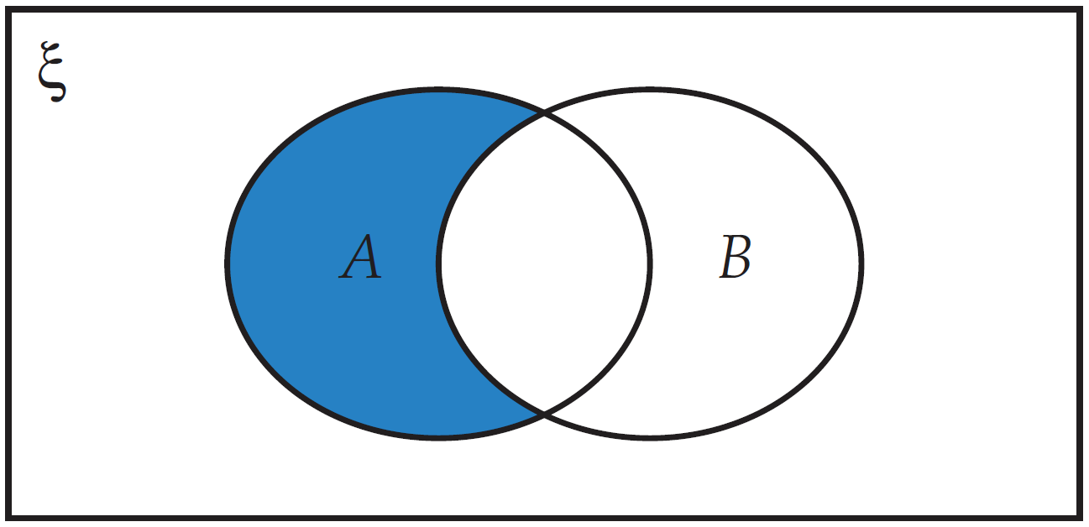
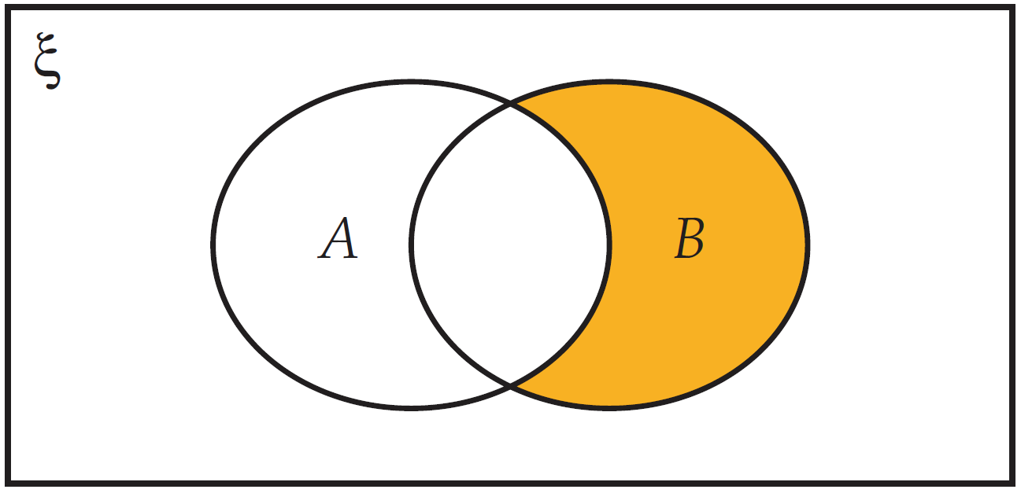
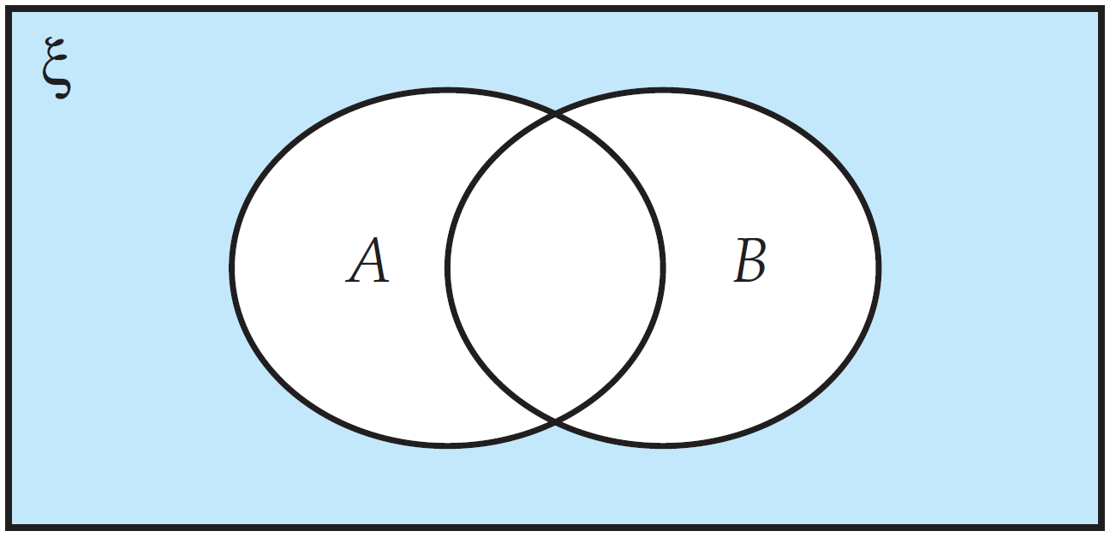
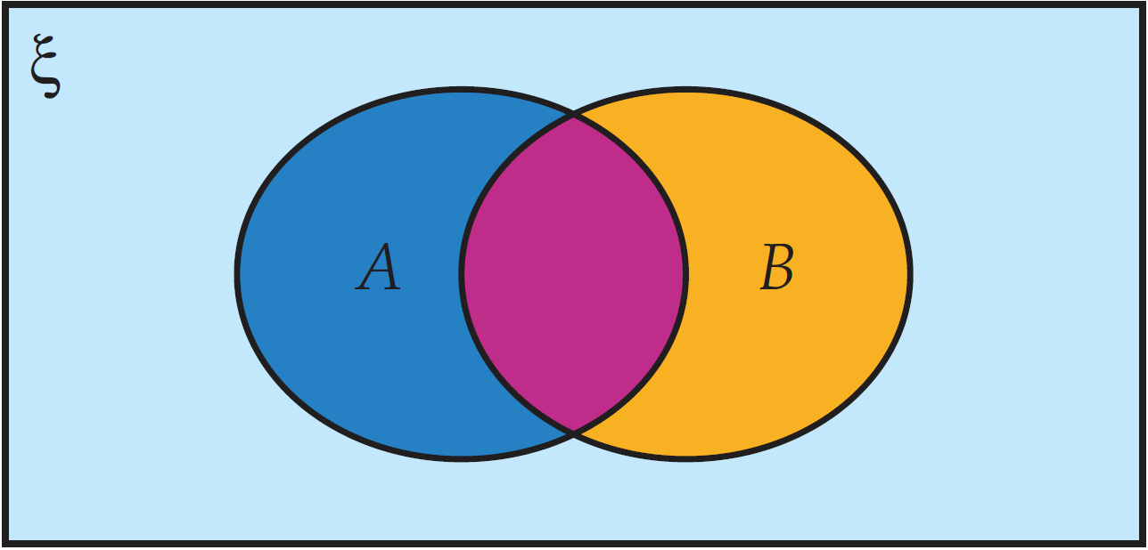
Concept Development
There are 4 areas to this Venn diagram.
This is the intersection of A and B. It is where both A and B occur.
This is the remainder of A. It is where A occurs but B does not.
This is the remainder of B. It is where B occurs but A does not.
This is any outcomes which do not fit into A or B.

Slide 14
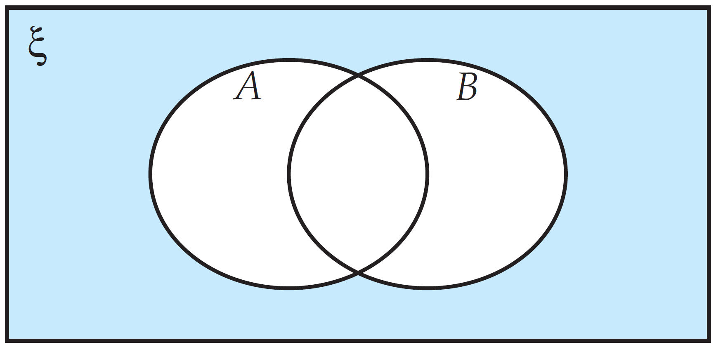
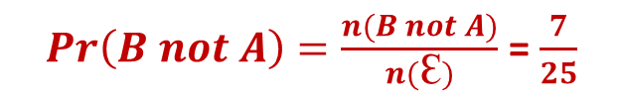
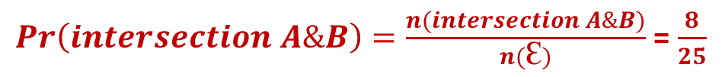
Skill Development
25 students all enjoy watching basketball (A), tennis (B) or basketball and tennis. 18 enjoy watching basketball and 15 enjoy watching tennis.
What is the probability that a student selected at random would:
Enjoy watching basketball and tennis?
b) Only enjoy watching tennis?
$Pr\left(intersection A\&B\right)=\frac{n(intersection A\&B)}{n(Ꜫ)}$ = $\frac{8}{25}$
18 + 15 = 33
Overlap
$Pr\left(B not A\right)=\frac{n(B not A)}{n(Ꜫ)}$ = $\frac{7}{25}$
33 – 25 = 8

Slide 15

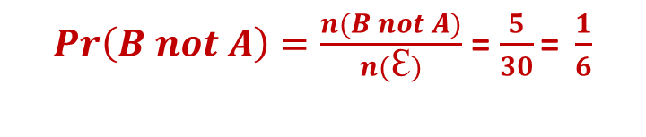
Guided Practice
30 students all enjoy the subject Science (A), Sport (B) or both. 16 enjoy Science and 25 enjoy Sport.
What is the probability that a student selected at random would:
Enjoy Science and Sport?
b) Only enjoy Science?
$Pr\left(intersection A\&B\right)=\frac{n(intersection A\&B)}{n(Ꜫ)}$ = $\frac{11}{30}$
16 + 25 = 41
Overlap
$Pr\left(B not A\right)=\frac{n(B not A)}{n(Ꜫ)}$ = $\frac{5}{30}\text{= }\frac{1}{6}$
41 – 30 = 11

Slide 16
Guided Practice
Who likes chocolate? (A) Who likes lollies? (B) You can put your hand up for one both or neither.
What is the probability that a student selected at random would:
Like chocolate and lollies?
b) Only like lollies?

Slide 17
Guided Practice
Who likes jelly? (A) Who likes ice cream? (B) You can put your hand up for one, both or neither.
What is the probability that a student selected at random would:
Like jelly and ice cream?
b) Only like jelly?

Slide 18
Independent Practice
Mathspace – Year 10 Mainstream Probability from Venn Diagrams CLASS WORK
30 students all enjoy the subject Science (A), Sport (B) or both. 16 enjoy Science and 25 enjoy Sport.
The union of A and B is everything in A or B.
The intersection of A and B is everything that’s in both A and B.
16 + 25 = 41
Overlap
41 – 30 = 11

